Slide 1
Compiler
Design
Predictive Parsing
assignment 01
prepared by firehiwot yibeltal
Bdu1411289

Slide 2
✔ predictive parsing theory ✔ explanation of program
✔ predictive parsing used ✔ grammar
✔ advantage of predictive parsing ✔ deirvation of string
✔ c++programming to count identifer ✔ parser tree
✔ c++ program ✔ conclusion
contents

Slide 3
What is Predictive Parsing? (Theory)
◆Predictive Parsing is a top-down parsing technique used in compiler design.
◆ It parses the input from left to right and constructs a leftmost derivation.
◆The parser predicts which grammar rule to apply by looking at:
✅ The current input symbol
✅ The parsing table
◆ it does not require backtracking, which makes it efficient.

Slide 4
Where is Predictive Parsing Used?
◆Used in syntax analysis phase of a compiler
◆Commonly applied for LL(1) grammars
◆Found in:
✅ Compiler front ends
✅ Programming language iinterpreters
✅ Educational compiler tools
◆ Helps in error detection and reporting

Slide 5
Advantages of Predictive Parsing
◆ Simple and fast parsing method
◆ Easy to implement using a stack
◆ Efficient for programming language grammars
◆ Clear structure for syntax validation

Slide 6

C++ Program to Count Identifiers
Concept
◆Identifiers are names given to variables, functions, etc.
◆Rules:
✅ Must start with a letter or underscore
✅ Can contain letters, digits, and underscores
✅ Keywords are not identifiers

Slide 7
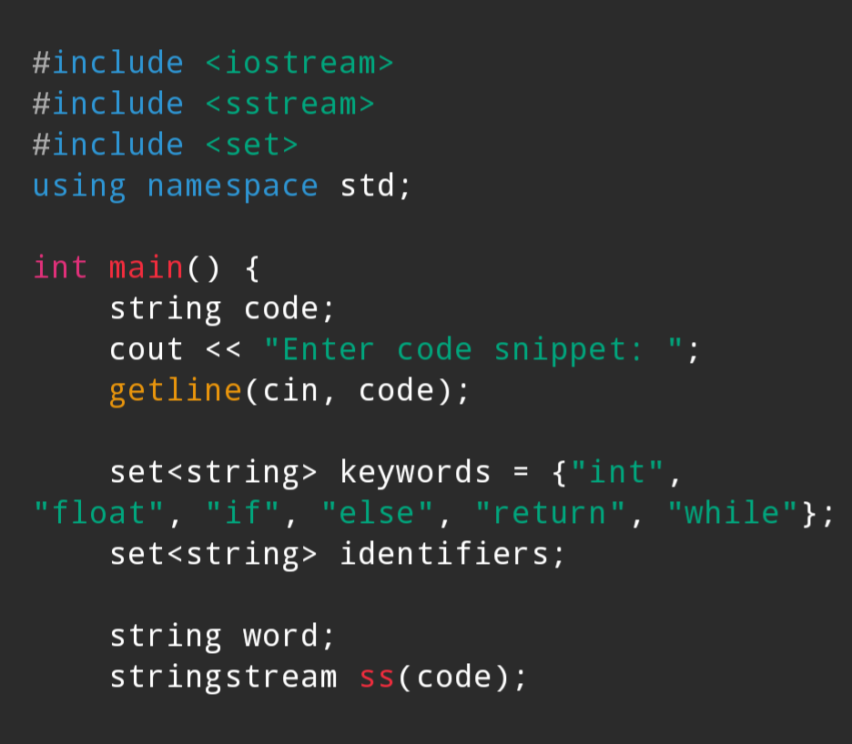
C++ Program

Slide 8
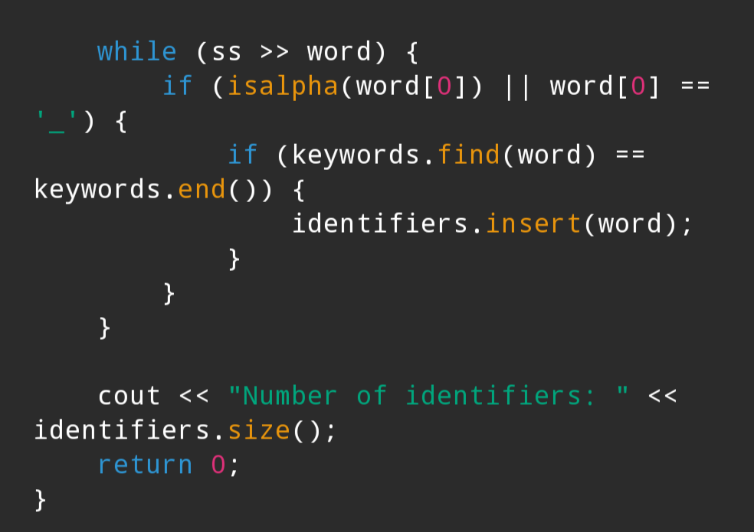

Slide 9
Explanation of the Program
◆ Reads a code snippet as input
◆ Uses string stream to extract words
◆ Filters out:
✅ Keywords
✅ Invalid identifiers
◆ Stores identifiers in a set to avoid duplicates
◆ Displays total identifier count

Slide 10
Grammar Given (Problem Solving)
S → 1S0 | 10
◆ This is a context-free grammar
◆ Generates strings starting with 1 and ending with 0
◆ Used to demonstrate recursive derivation

Slide 11

Derivation of String "11010"
◆ Leftmost Derivation
S → 1S0
S → 10
◆ Substituting
1(10)0 = 11010
The string 11010 is generated by the grammar.

Slide 12
S
/ | \
1 S 0
|
10
Parse Tree for "11010"

Slide 13
◆ Root symbol is S
◆ Rule applied: S → 1S0
◆ Inner S expands to 10
◆ Leaf nodes form the string 11010
◆ Demonstrates top-down parsing
Explanation of Parse Tree

Slide 14
Conclusions
◆Predictive parsing is a key concept in compiler design.
◆Identifier counting shows practical lexical analysis.
◆Grammar and parse tree explain syntax structure.
◆Together, these concepts form the foundation of compilers.

Slide 15
thank you

